Slide 1
Lead scoring Case study
Partner 1 Name- Subrata Malik
Partner 1 Mail id- sbrtmalik@gmail.com
Partner 1 Contact details- 919681603500
Partner 2 Name- Atreyee Chatterjee
Partner 2 Mail id- aisha63@gmail.com
Partner 2 Contact details- 919007667144
Partner 3 Name- Abinesh Durai S K
Partner 3 Mail id- somiabinesh91@gmail.com
Partner 3 Contact details- 919902404546

Slide 2
Problem statement
An X Education need help to select the most promising leads, i.e. the leads that are most likely to convert into paying customers. The company requires us to build a model wherein you need to assign a lead score to each of the leads such that the customers with higher lead score have a higher conversion chance and the customers with lower lead score have a lower conversion chance. The CEO, in particular, has given a ballpark of the target lead conversion rate to be around 80%.

Slide 3
Goals and Objectives
Build a logistic regression model to assign a lead score between 0 and 100 to each of the leads which can be used by the company to target potential leads. A higher score would mean that the lead is hot, i.e. is most likely to convert whereas a lower score would mean that the lead is cold and will mostly not get converted.
There are some more problems presented by the company which your model should be able to adjust to if the company's requirement changes in the future so you will need to handle these as well. These problems are provided in a separate doc file. #Please fill it based on the logistic regression model you got in the first step. Also, make sure you include this in your final PPT where you'll make recommendations.

Slide 4
Build a logistic regression model to assign a lead score between 0 and 100 to each of the leads which can be used by the company to target potential leads.

Slide 5
DATA interpretation – univaraiate and Bi variate analysis

Slide 6
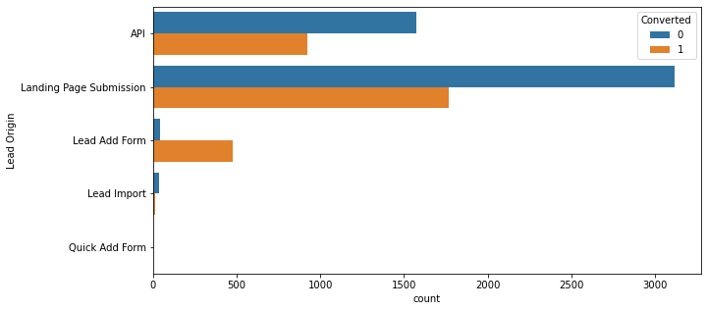
From Lead Origin finding, maximum lead conversion happened from Landing Page Submission.

Slide 7
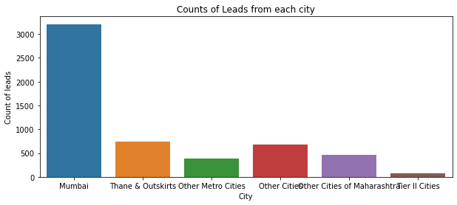
Mumbai is the most common city where the leads came from.

Slide 8
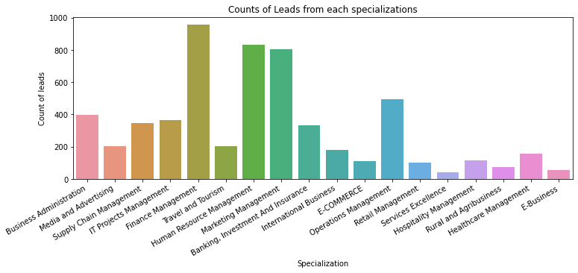
Specialization: fin man and followed by marketing man and hr man are the most preferred specializations

Slide 9
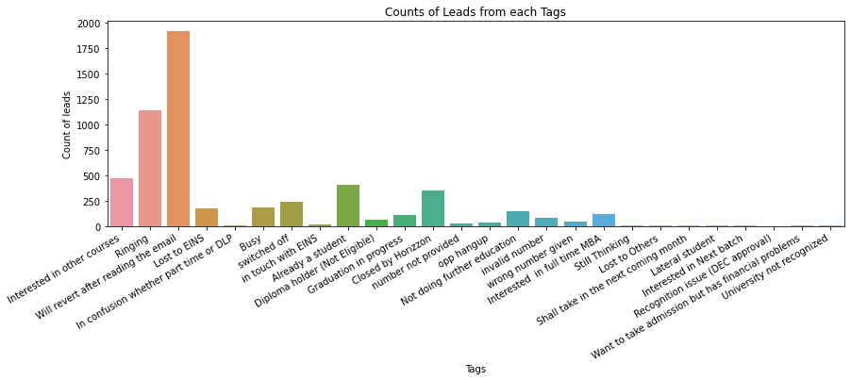
Count of lead from each TAGs

Slide 10
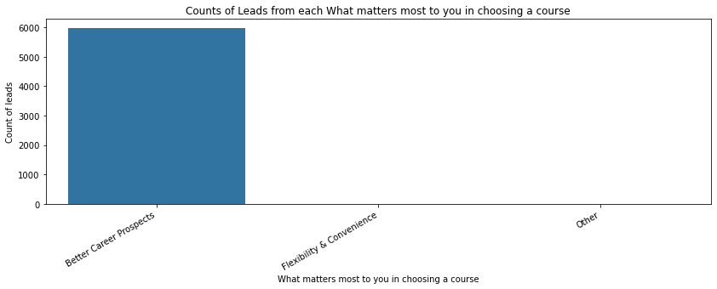
Most preferred reason for choosing online course: Better career prospect

Slide 11
#Dropping the columns which are having null values greater than 30% As per below there are seven features where null% is greater than 30%. We can drop such columns as 30% data is missing in them.
 | Null%
How did you hear about X Education | 75.00
Lead Profile | 71.88
Lead Quality | 46.55
Asymmetrique Activity Score | 44.16
Asymmetrique Activity Index | 44.16
Asymmetrique Profile Index | 44.16
Asymmetrique Profile Score | 44.16
What matters most to you in choosing a course | 24.75
What is your current occupation | 24.51
Country | 14.83
TotalVisits | 1.72
Page Views Per Visit | 1.72
Last Activity | 1.29
Lead Source | 0.41

Slide 12
EDA

Slide 13
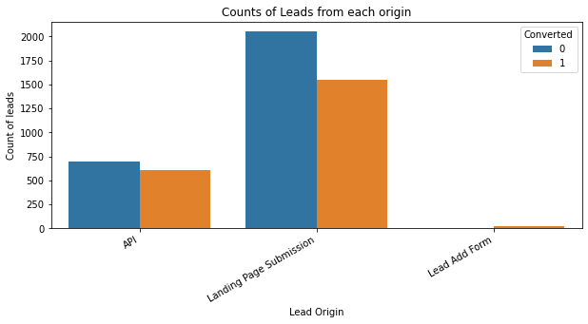
#plotting the counts of data points per year
#Inference
#API and Landing Page Submission have 30-35% conversion rate but count of lead originated from them are considerable.
#Lead Add Form has more than 90% conversion rate but count of lead are not very high.

Slide 14
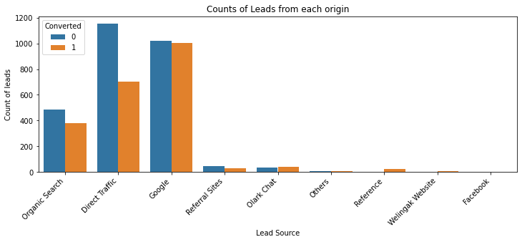
#plotting the counts of leads per year
#Inference
#Google and Direct traffic* sources generated the highest leads.

Slide 15
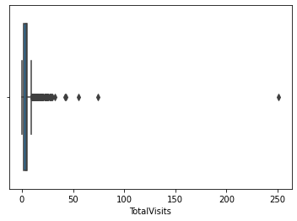
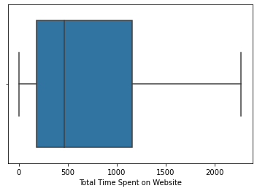
#Box Plot of Continuous Features

Slide 16
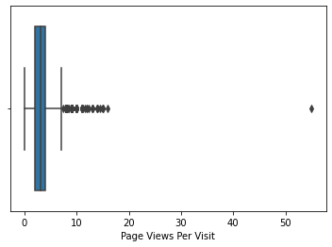
#Box Plot of Continuous Features
#Inference
#There are more outliers in TotalVisits & Page Visits per View
#We'll handle these outliers by capping them in either average or with any other function.

Slide 17
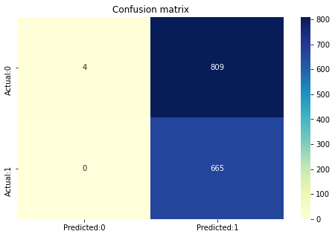
Logistic regression model

Slide 18
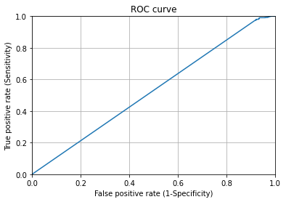
ROC curve

Slide 19
Model Interpretation
After running the model on the Test Data these are the figures we obtain:
Accuracy : ROC AUC score :52.87%
Sensitivity: 100%
Specificity : 49.20%
While we have checked both Sensitivity-Specificity as well as Precision and Recall Metrics, we have considered the optimal cut off based on Sensitivity and Specificity for calculating the final prediction.
Accuracy, Sensitivity and Specificity values of test set are approximately closer to the respective values calculated using trained set.
Also the lead score calculated in the trained set of data shows the conversion rate on the final predicted model is around 52.9%
Hence overall this model does not seem to be good.

Slide 20
Conclusion
It was found that the variables that mattered the most in the potential leads are (In descending order) :
The total time spend on the Website.
Total number of visits.
When the lead source was:
Google
Direct traffic
Organic search
When the last activity was:
SMS
Olark chat conversation
Keeping these in mind the X Education can flourish as they have a very low chance to get almost all the potential buyers to change their mind and buy their courses hence they should focus on other marketing activity to improve awareness and draw more customers on to their website..

